Slide 1
Express X Angular
By
Asif Hasan

Slide 2
Initial Environment Setup

Slide 3
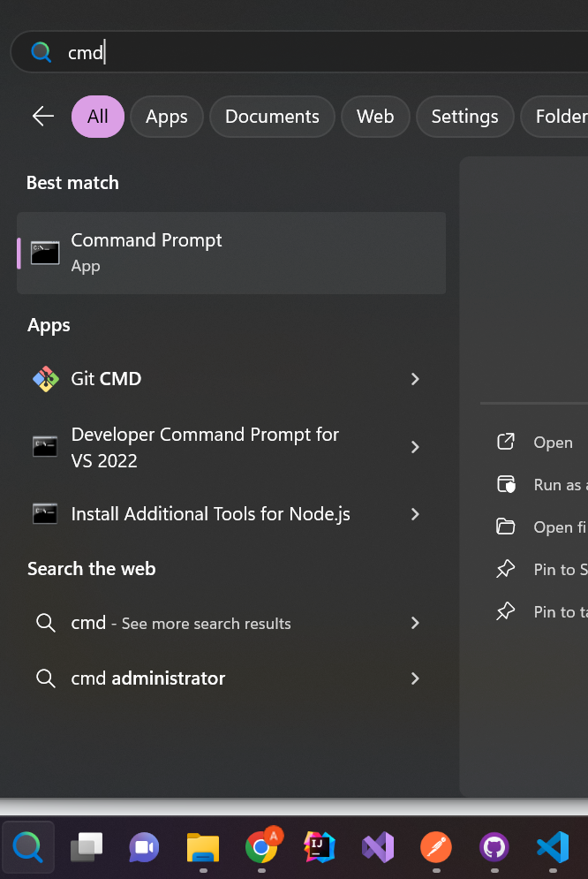
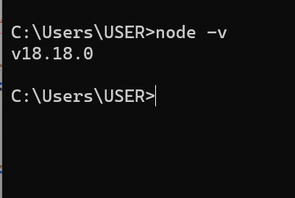
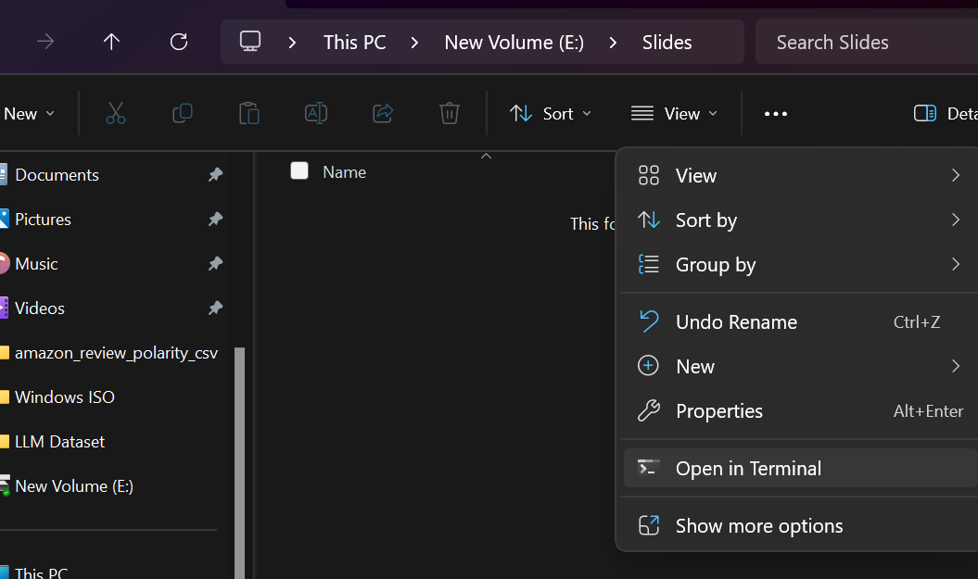
Go to CMD
Check node version using node -v
If node -v is not showing then download and install node.js
Make a new folder then go to that folder and open CMD

Slide 4
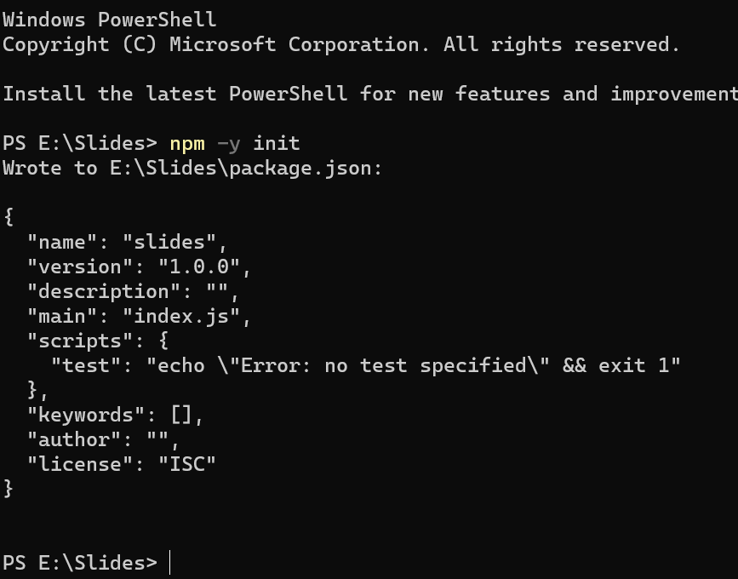
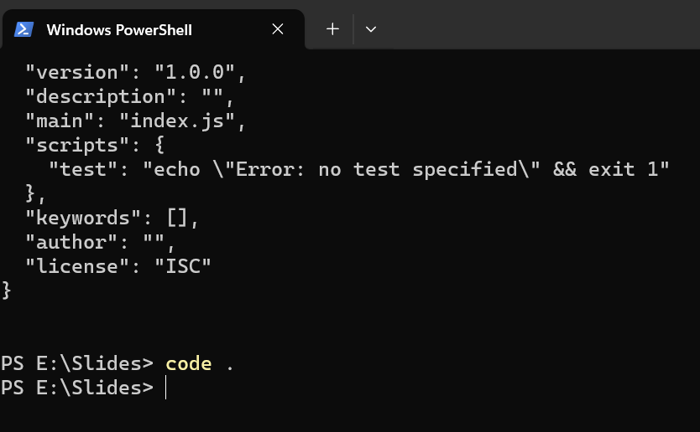
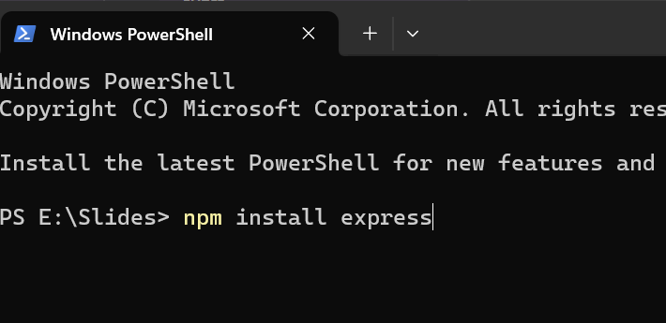

Write npm -y init
It will give initial dependencies for the express project
Write code . will open the project file in IDE vsCode
Write down this for making database query
Write down this will complete express js

Slide 5
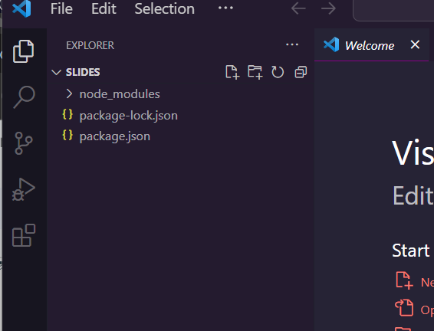
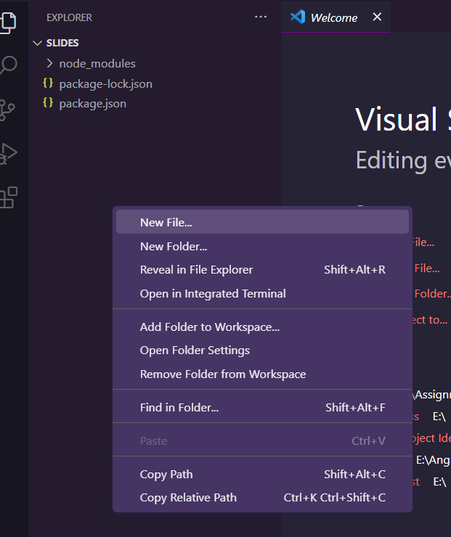
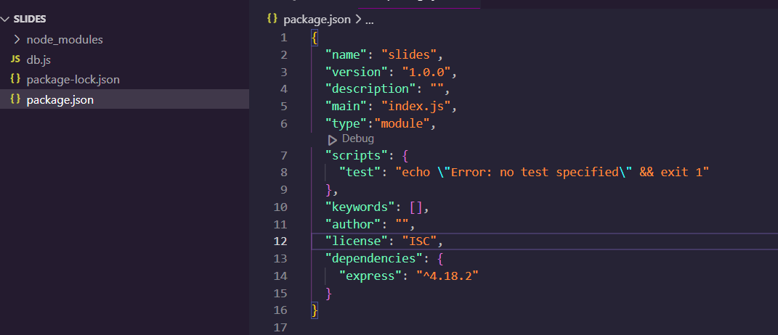
Current situation of the project folder and go to package.json
Create new file name like db.js
“type:”module,
Add this will Allow import library to different js files

Slide 6
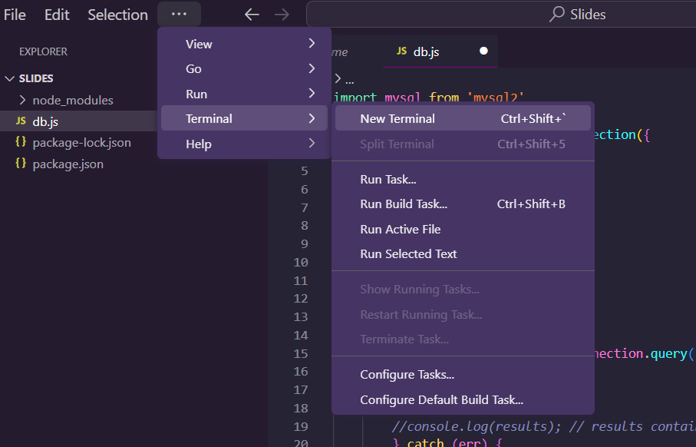
You can use IDE terminal to make command

Slide 7
Initial Express JS Setup

Slide 8
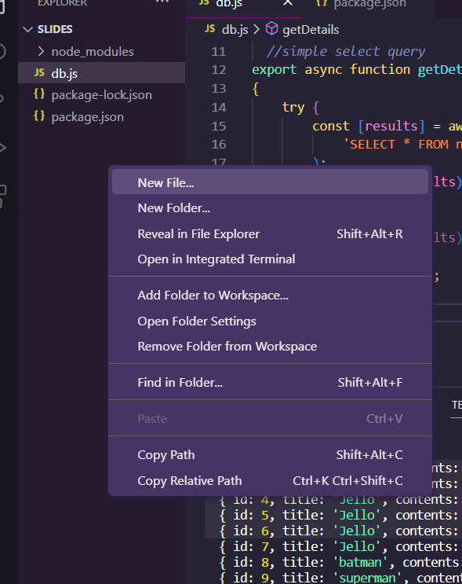
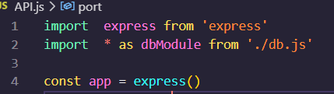
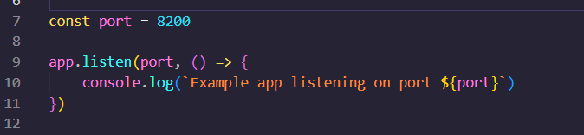
Import express to create object of express
Import express to create object of express
Import express to create object of express
Import db.js file as dbModule to Access the CRUD methods
The port number is necessary to make the server Available for end users to Access.
Now create Another js file to create API endpoint that can be called from
Client Side/Angular
app.listen() will Active the site on the port no 8200

Slide 9
Initial DB Connection Establish

Slide 10
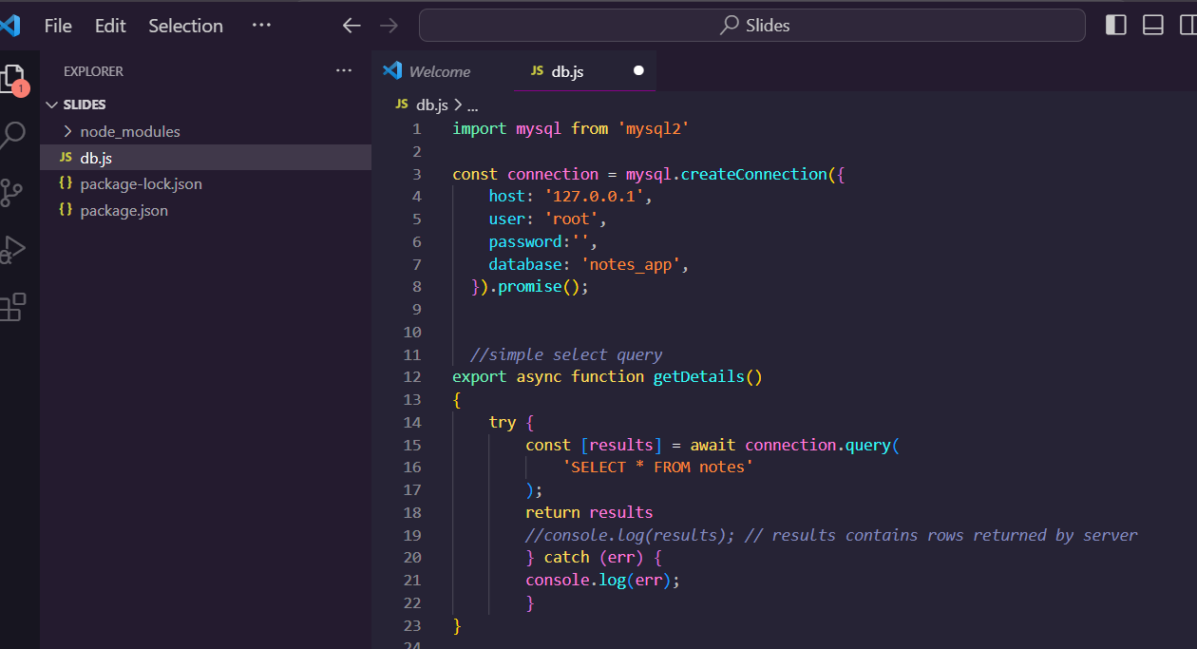
Import the pre-installed sql library to make the sql query
Async and Await used together to make basic select query to Achieve Asynchronous behaviour of js
Provide all database information to establish connection with mysql database
export keyword allows the function to be imported/called in other files

Slide 11
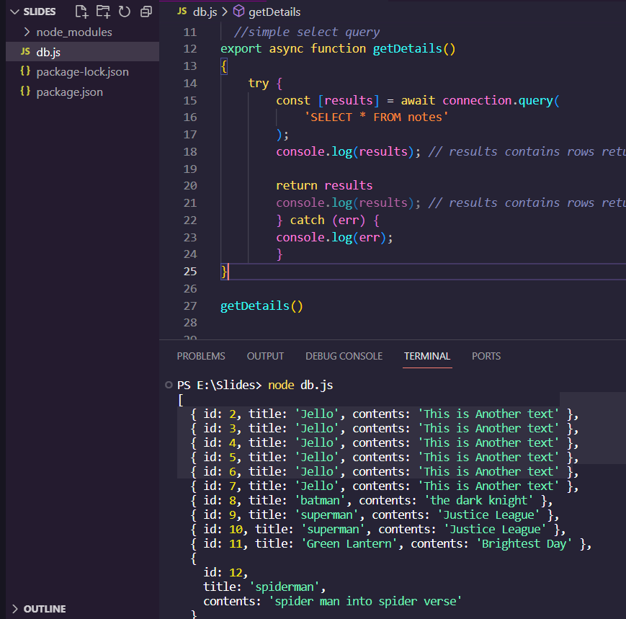
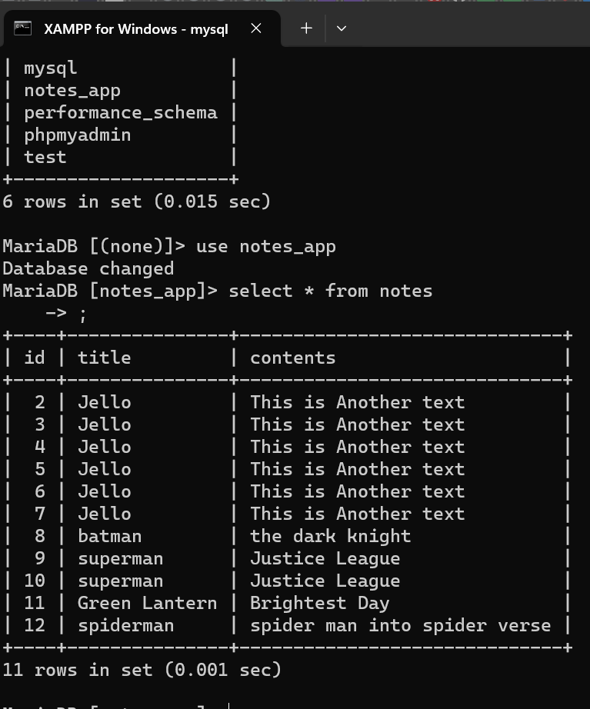
Checking it from mysql db
Run this now fetching All information from db. The method we called is getDetails()

Slide 12
Now create EndPoint & Access Data

Slide 13
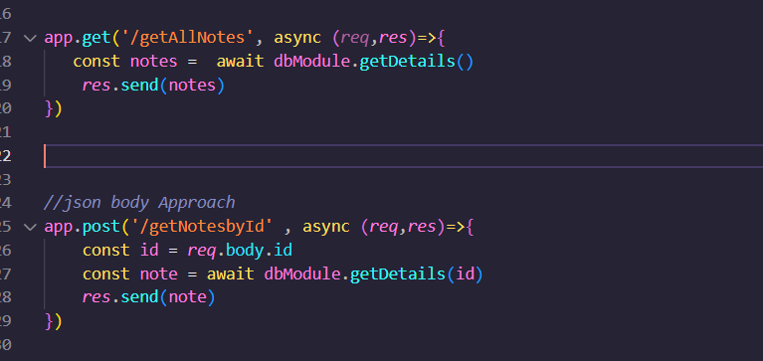
Get / Post Request

Slide 14
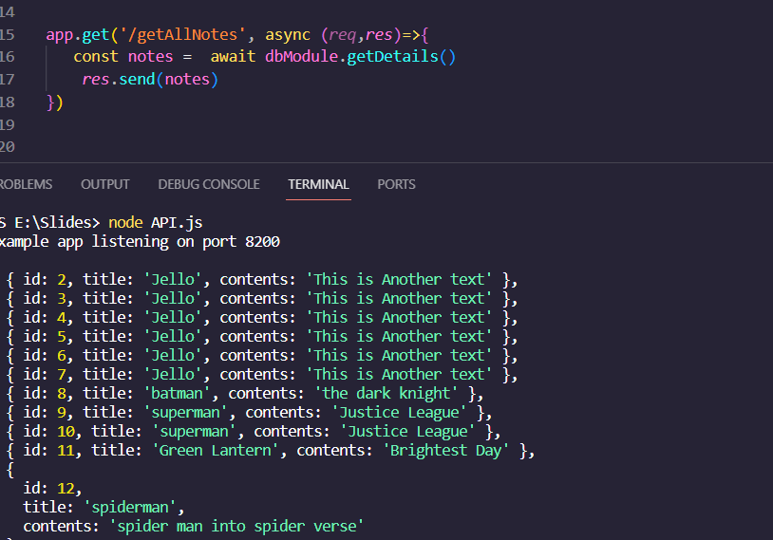
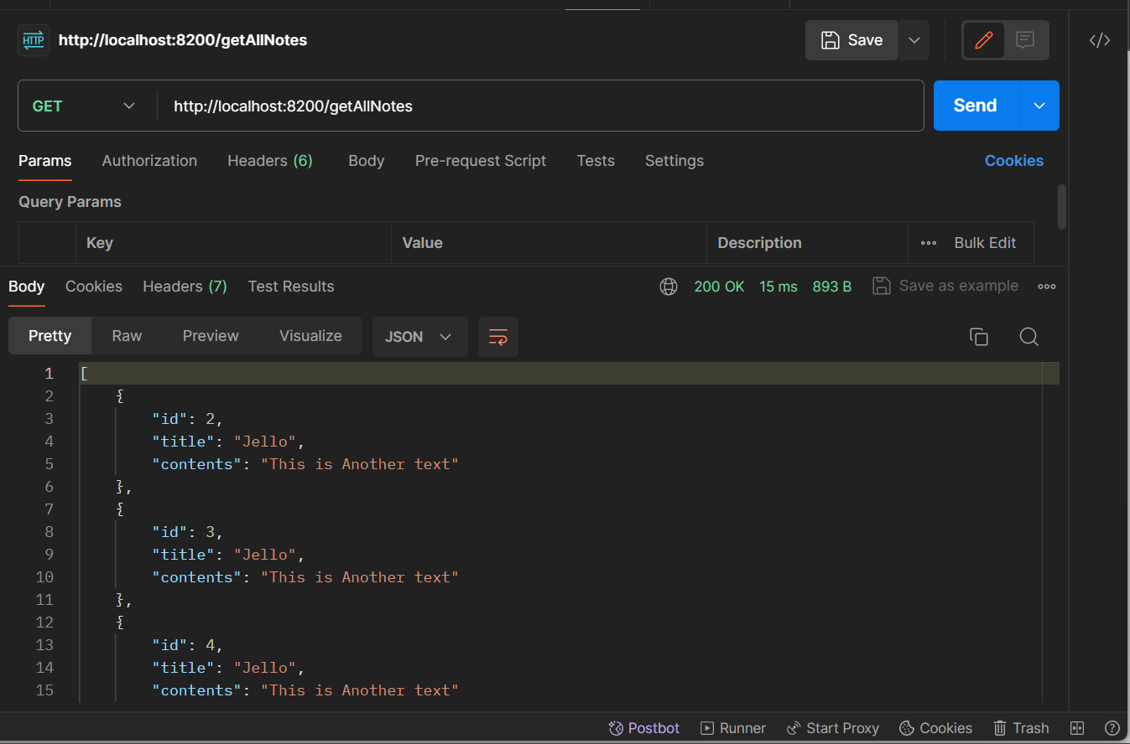
App.get is for get Request. The dbModule.getDetails() will call the database module

Slide 15
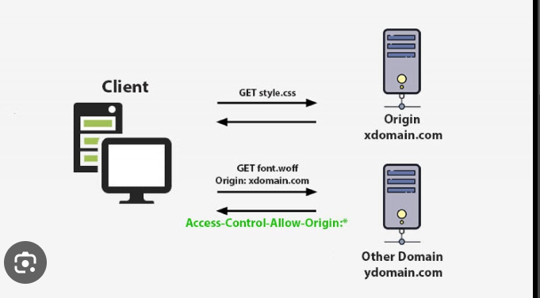
Setup CORS Policy for Communication between UI & backend

Slide 16
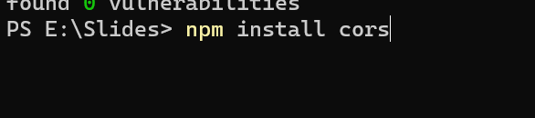
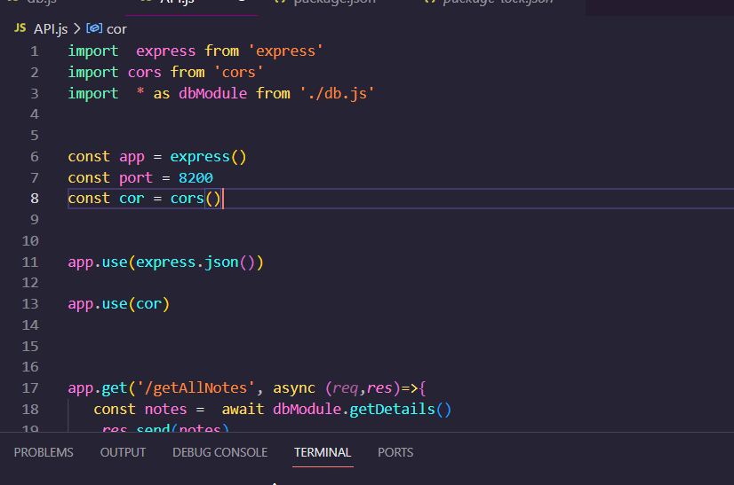
Run this command to setup cors
Import the cors libary
Create obj of cors
Use the cors policy

Slide 17
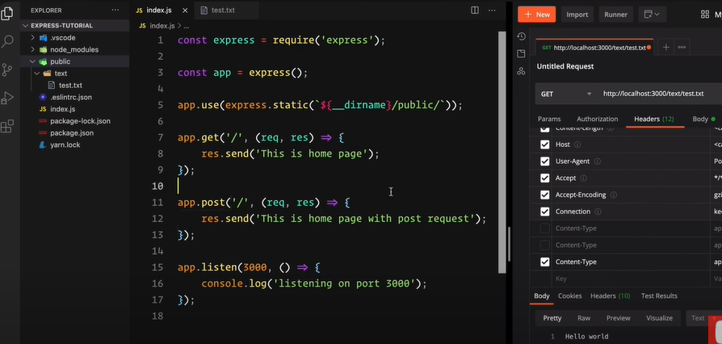

Slide 18
ANGULAR SETUP

Slide 19
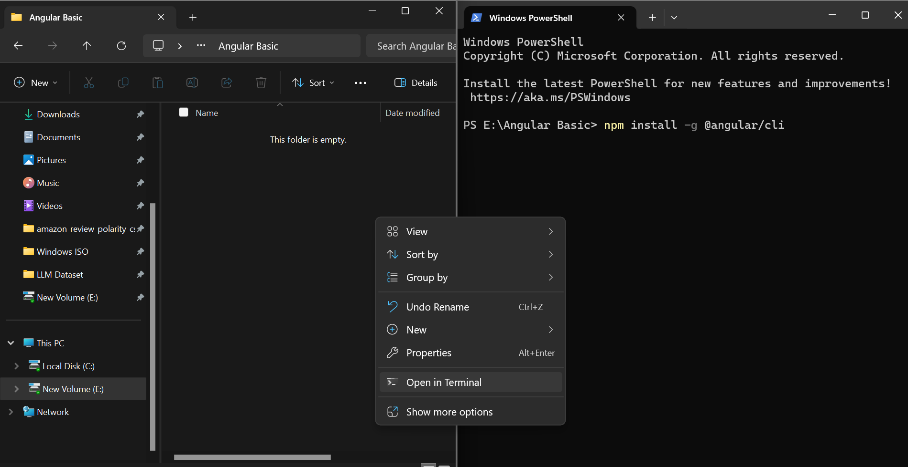
Again Just make a new folder opened CMD in that folder write down
npm install -g @angular/cli

Slide 20
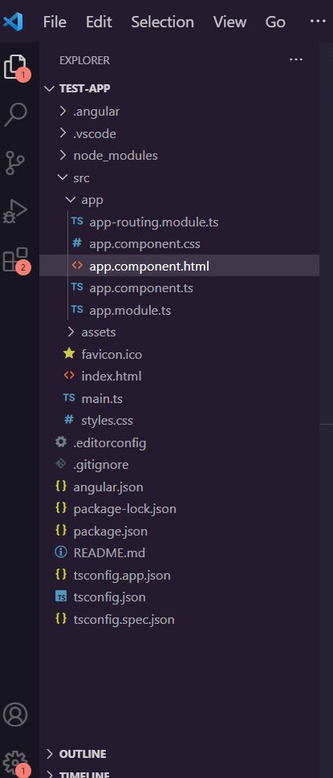
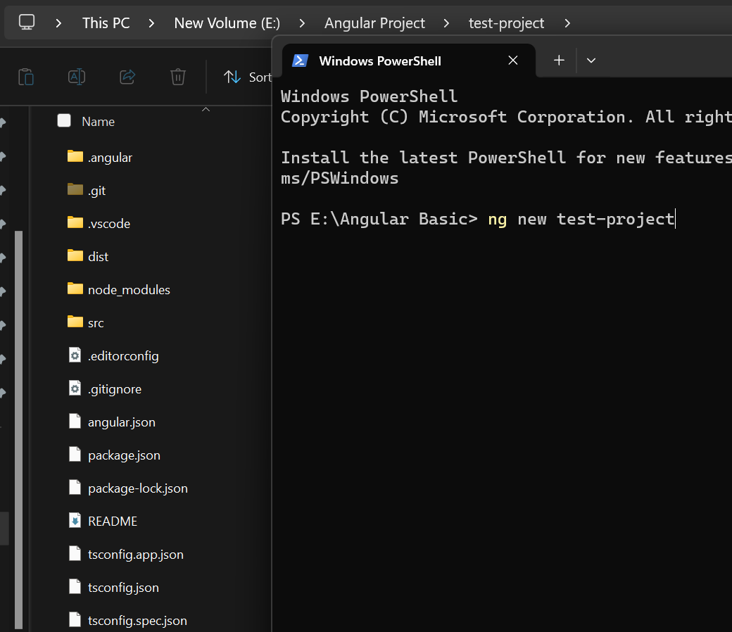
Then type ng new ‘test-project’ to create new project
This is how the file structure looks after creating the project
This is how the file structure looks after creating the project

Slide 21
App.component.css will carry css content
App.component.html will carry html content
App.component.ts will carry js content
App.module.ts holds All library details

Slide 22
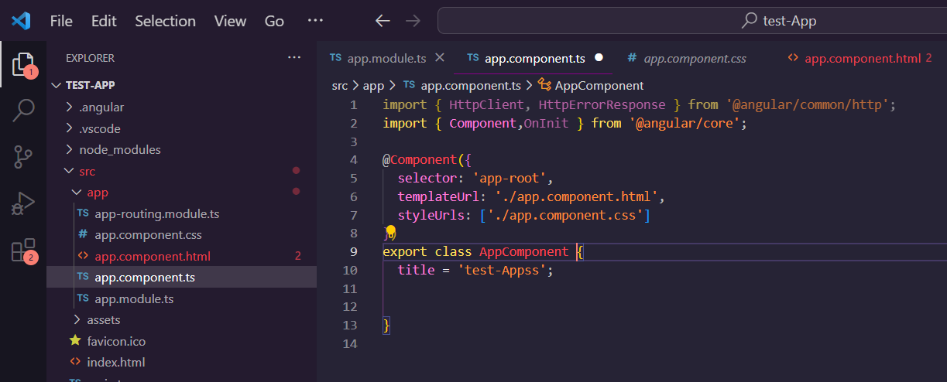
Initial Look of App.component.ts

Slide 23
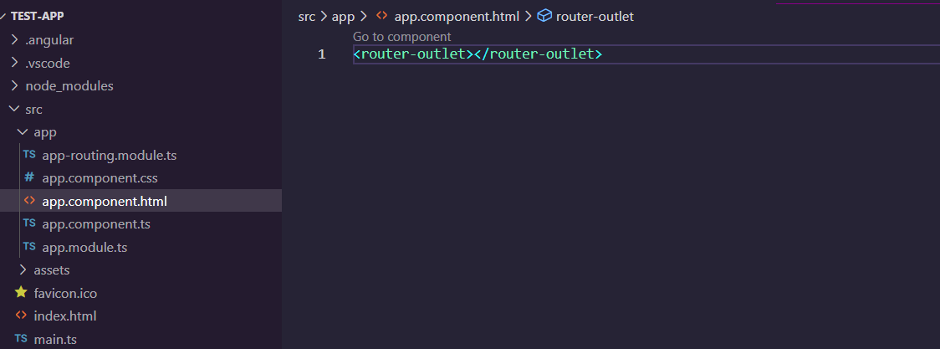
Initial Look of App.component.html

Slide 24
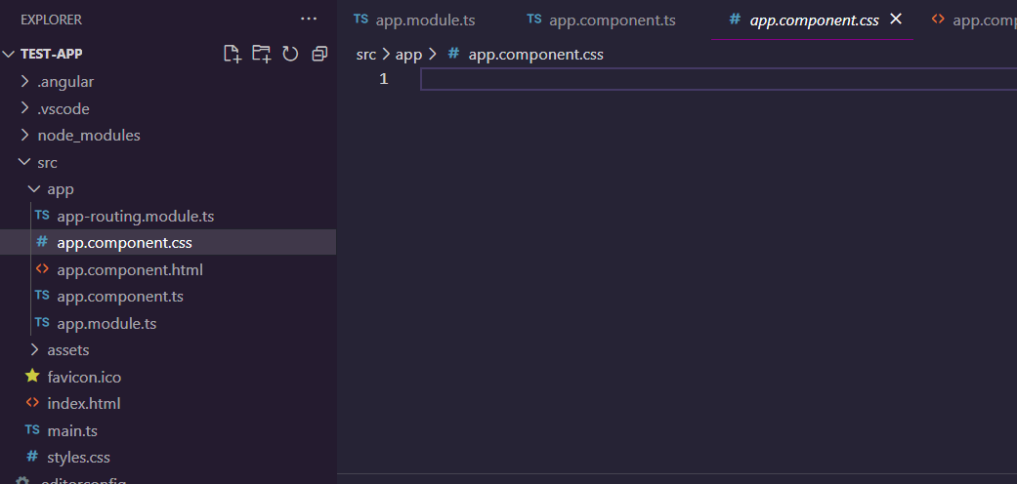
Initial Look of App.component.css

Slide 25
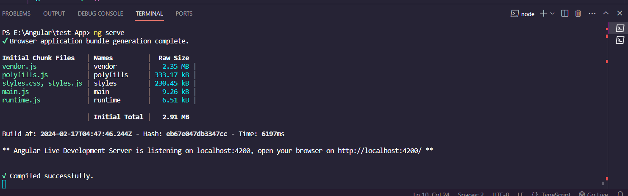

Slide 26
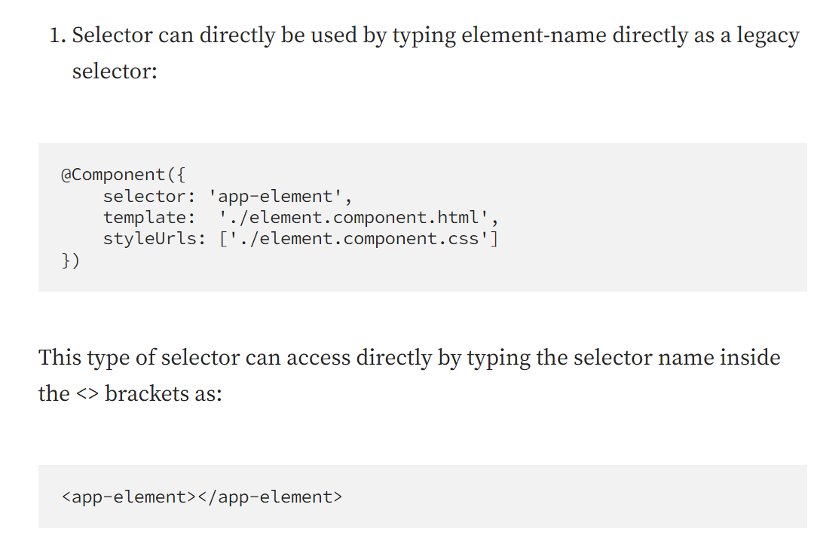

Slide 27
How to Create Modules, Components, Services?
ng g m module_name
ng g c comonent_name
ng g s service_name

Slide 28
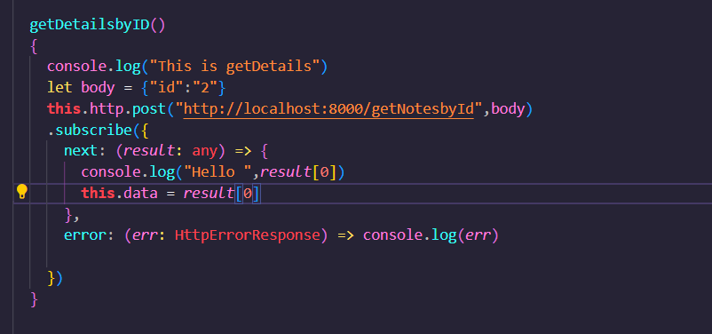
Call API from FrontEnd
Call API from Angular Projectc

Slide 29
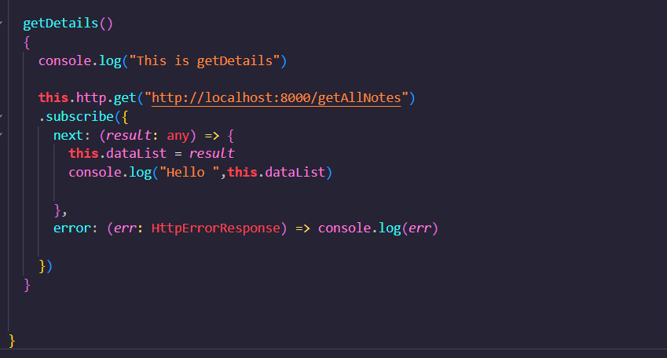
Call API from FrontEnd

Slide 30
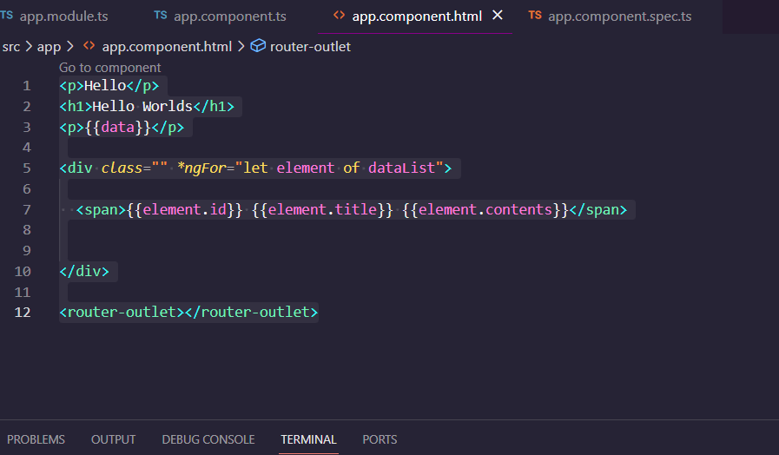
Showing Data in app.component.html

Slide 31
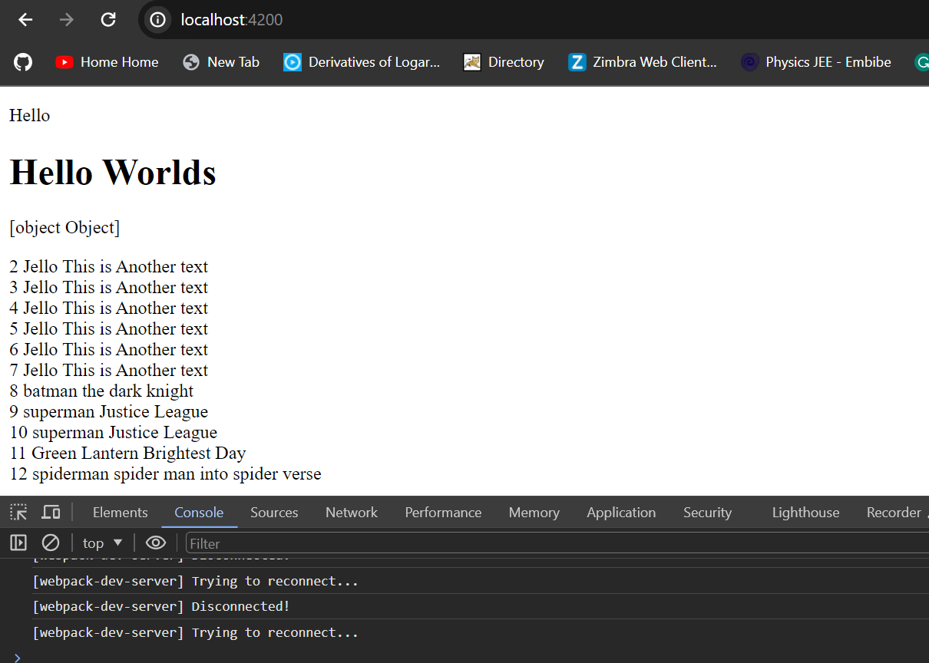
Write down ng serve and see the database data in UI

Slide 32
XAMPP Installation Process

Slide 33
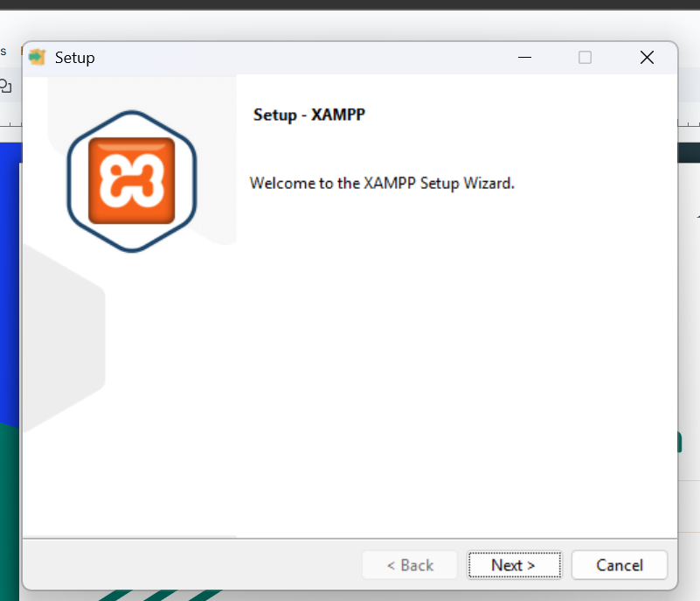
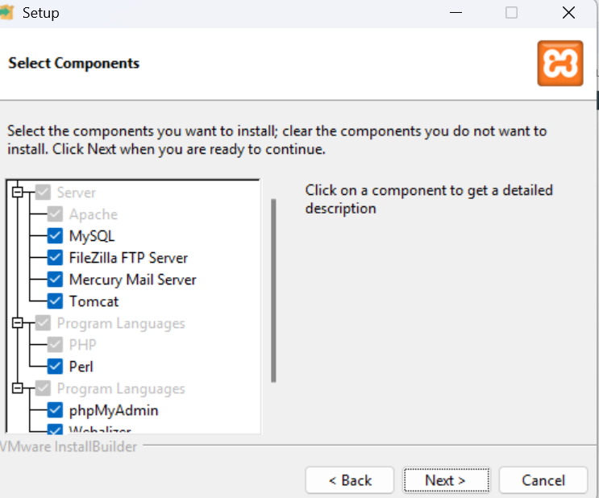
STEP 1
STEP 2

Slide 34
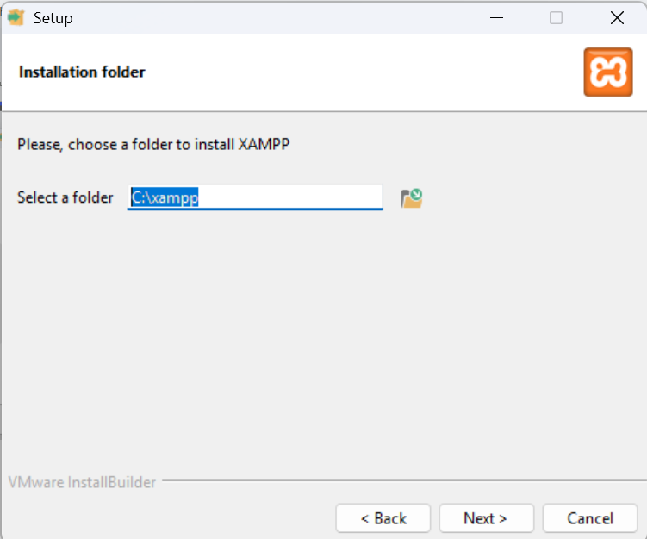
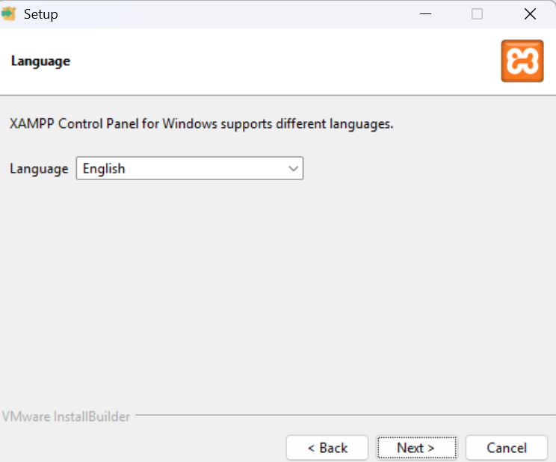
STEP 3
STEP 4

Slide 35
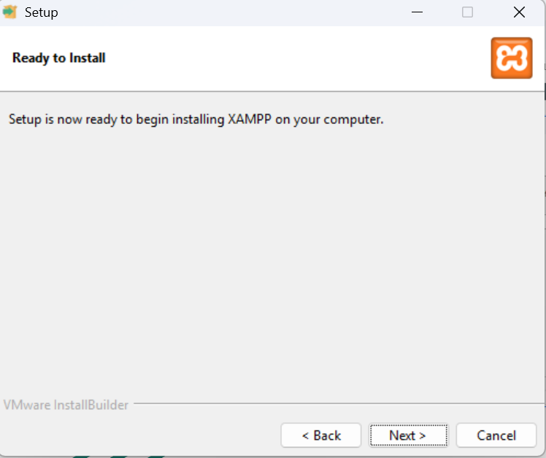
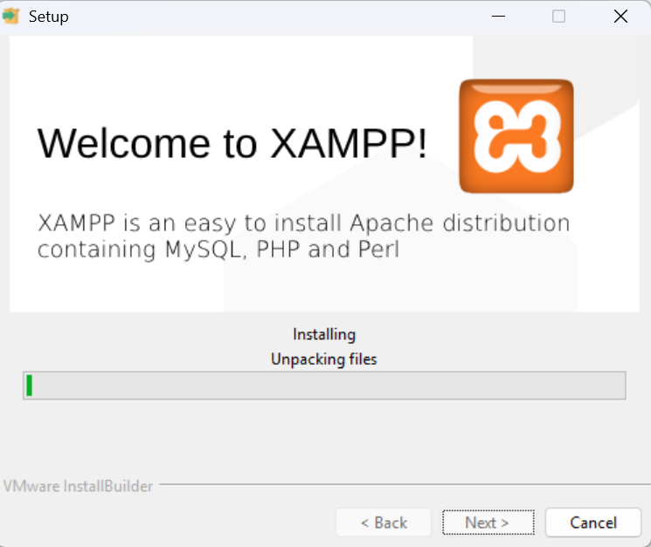
STEP 5
STEP 6
Wait until it’s finished

